Slide 1


Machine Learning 6. Regularization
Xueyuan Gong
School of Intelligent Systems Science and Engineering

Slide 2
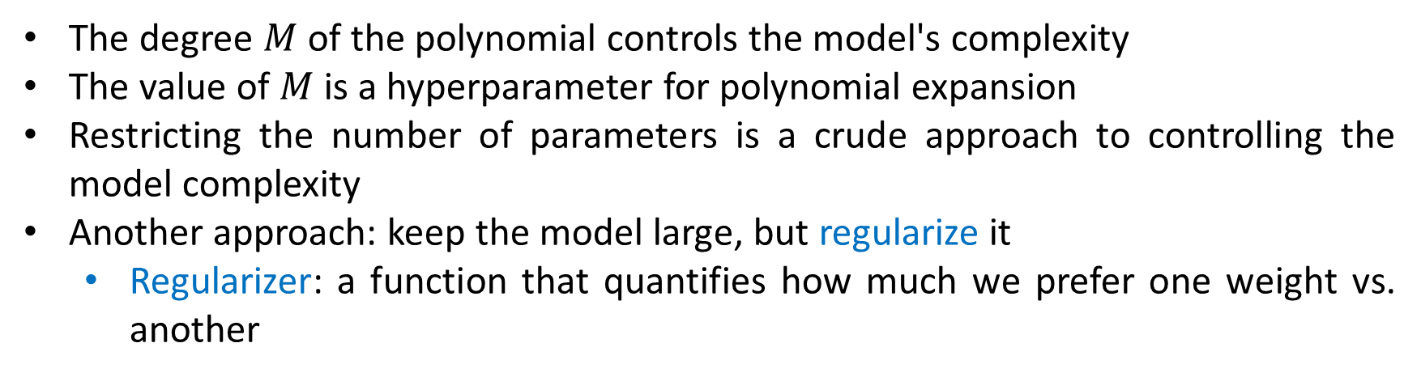
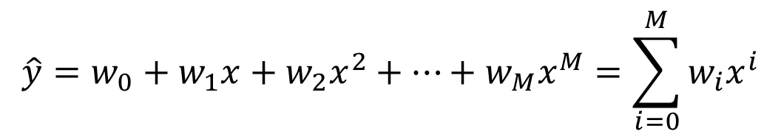
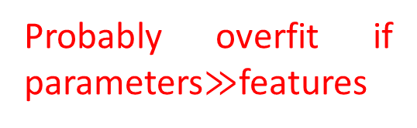

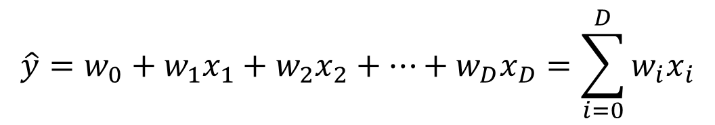
Regularization
Probably overfit if parameters$≫$features
$$\hat{y}=w_{0}+w_{1}x_{1}+w_{2}x_{2}+…+w_{D}x_{D}=\sum_{i=0}^{D}{w_{i}x_{i}}$$
$D$ features
$$\hat{y}=w_{0}+w_{1}x+w_{2}x^{2}+…+w_{M}x^{M}=\sum_{i=0}^{M}{w_{i}x^{i}}$$
One feature
The degree $M$ of the polynomial controls the model's complexity
The value of $M$ is a hyperparameter for polynomial expansion
Restricting the number of parameters is a crude approach to controlling the model complexity
Another approach: keep the model large, but regularize it
Regularizer: a function that quantifies how much we prefer one weight vs. another

Slide 3
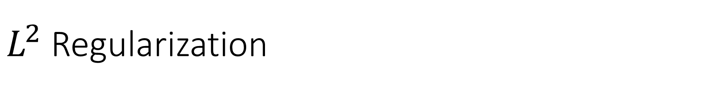
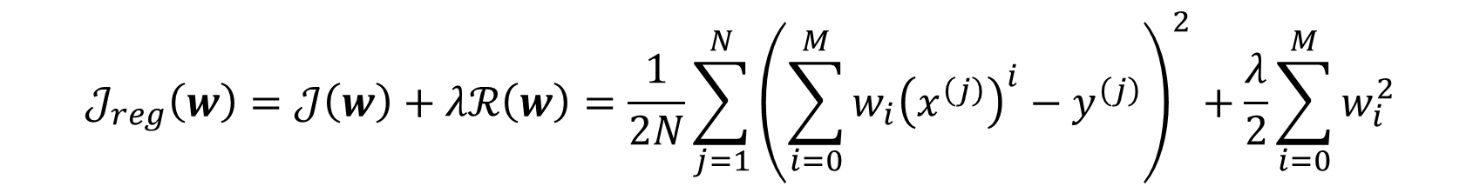

$L^{2}$ Regularization
We can encourage the weights to be small by choosing as our regularizer the $L^{2}$ penalty
$$ℛ\left(w\right)=\frac{1}{2}{\left\|w\right\|}_{2}^{2}=\frac{1}{2}\sum_{i=0}^{M}{w_{i}^{2}}$$
The regularized cost function makes a tradeoff between fit to the data and the norm of the weights
$$𝒥_{reg}\left(w\right)=𝒥\left(w\right)+λℛ\left(w\right)=\frac{1}{2N}\sum_{j=1}^{N}{{\left(\sum_{i=0}^{M}{w_{i}{\left(x^{\left(j\right)}\right)}^{i}}−y^{\left(j\right)}\right)}^{2}}+\frac{λ}{2}\sum_{i=0}^{M}{w_{i}^{2}}$$
If you fit training data poorly, $𝒥$ is large. If your optimal weights have high values, $ℛ$ is large

Slide 4
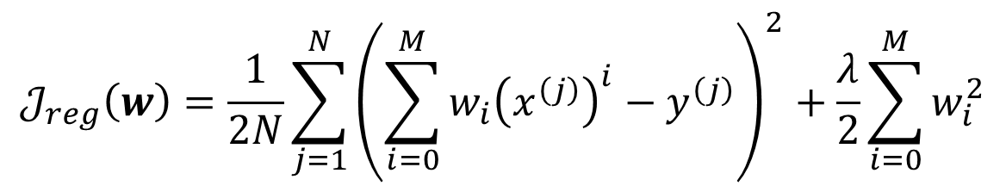

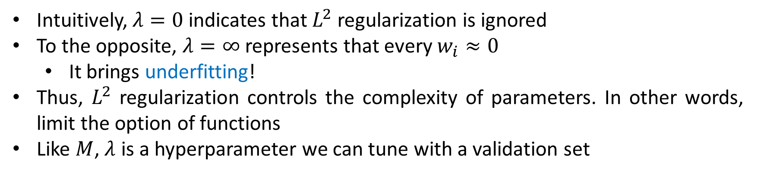
Intuition for $L^{2}$ Regularization
$$𝒥_{reg}\left(w\right)=\frac{1}{2N}\sum_{j=1}^{N}{{\left(\sum_{i=0}^{M}{w_{i}{\left(x^{\left(j\right)}\right)}^{i}}−y^{\left(j\right)}\right)}^{2}}+\frac{λ}{2}\sum_{i=0}^{M}{w_{i}^{2}}$$
Intuitively, $λ=0$ indicates that $L^{2}$ regularization is ignored
To the opposite, $λ=∞$ represents that every $w_{i}≈0$
It brings underfitting!
Thus, $L^{2}$ regularization controls the complexity of parameters. In other words, limit the option of functions
Like $M$, $λ$ is a hyperparameter we can tune with a validation set

Slide 5
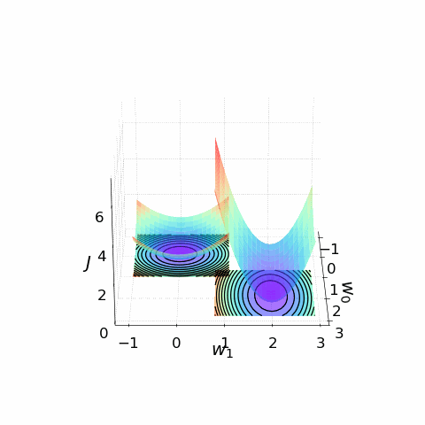
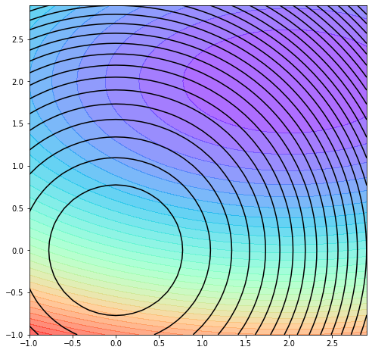

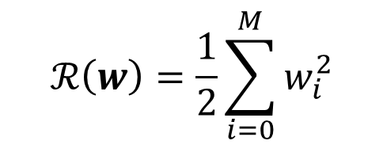
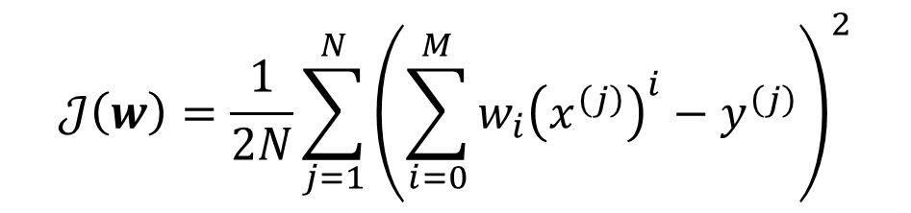
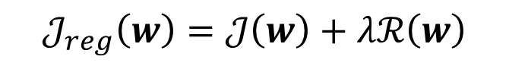
Intuition $L^{2}$ Regularization
$$𝒥_{reg}\left(w\right)=𝒥\left(w\right)+λℛ\left(w\right)$$
$$𝒥\left(w\right)=\frac{1}{2N}\sum_{j=1}^{N}{{\left(\sum_{i=0}^{M}{w_{i}{\left(x^{\left(j\right)}\right)}^{i}}−y^{\left(j\right)}\right)}^{2}}$$
$$ℛ\left(w\right)=\frac{1}{2}\sum_{i=0}^{M}{w_{i}^{2}}$$

Slide 6
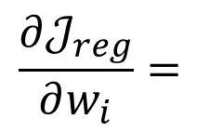
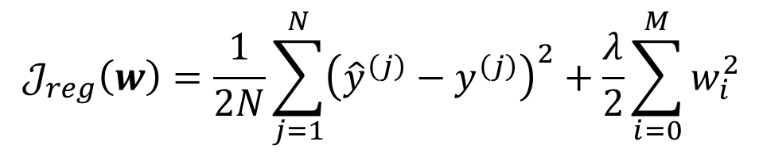
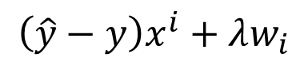
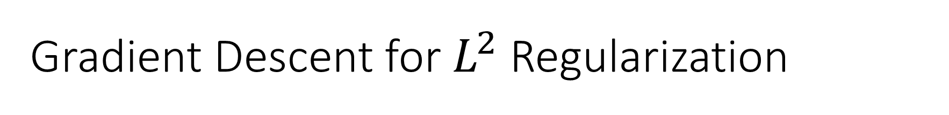
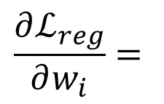
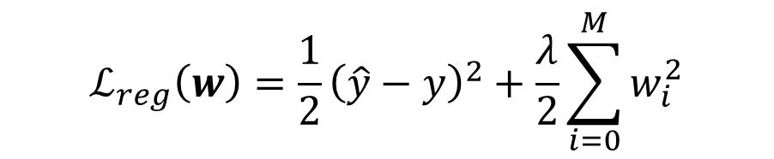
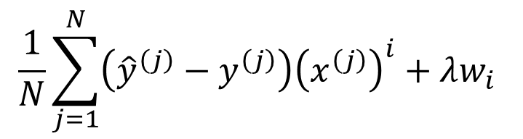
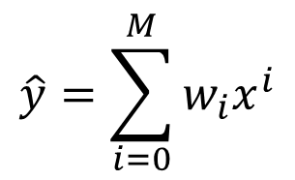
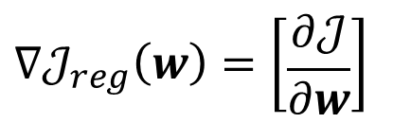
Gradient Descent for $L^{2}$ Regularization
Model
Loss Function
$$\hat{y}=\sum_{i=0}^{M}{w_{i}x^{i}}$$
$$ℒ_{reg}\left(w\right)=\frac{1}{2}{\left(\hat{y}−y\right)}^{2}+\frac{λ}{2}\sum_{i=0}^{M}{w_{i}^{2}}$$
$$\frac{∂ℒ_{reg}}{∂w_{i}}=$$
$$\left(\hat{y}−y\right)x^{i}+λw_{i}$$
Cost Function
$$𝒥_{reg}\left(w\right)=\frac{1}{2N}\sum_{j=1}^{N}{{\left({\hat{y}}^{\left(j\right)}−y^{\left(j\right)}\right)}^{2}}+\frac{λ}{2}\sum_{i=0}^{M}{w_{i}^{2}}$$
Gradient
$$\frac{1}{N}\sum_{j=1}^{N}{\left({\hat{y}}^{\left(j\right)}−y^{\left(j\right)}\right){\left(x^{\left(j\right)}\right)}^{i}}+λw_{i}$$
$$∇𝒥_{reg}\left(w\right)=\left[\begin{matrix}\frac{∂𝒥}{∂w}\end{matrix}\right]$$
$$\frac{∂𝒥_{reg}}{∂w_{i}}=$$

Slide 7
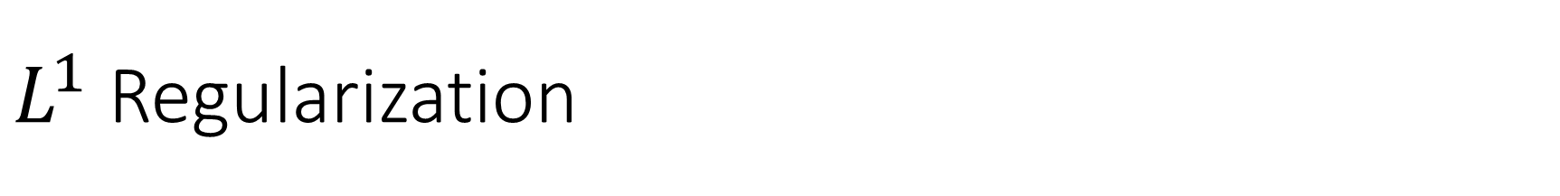
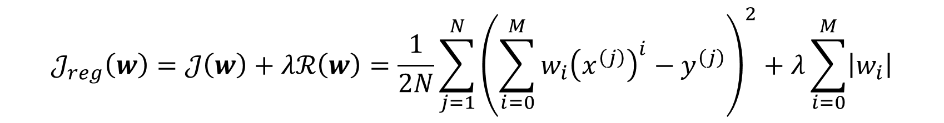

$L^{1}$ Regularization
We can encourage the weights to be small by choosing as our regularizer the $L^{1}$ penalty
$$ℛ\left(w\right)={\left\|w\right\|}_{1}^{2}=\sum_{i=0}^{M}{\left|w_{i}\right|}$$
The regularized cost function makes a tradeoff between fit to the data and the norm of the weights
$$𝒥_{reg}\left(w\right)=𝒥\left(w\right)+λℛ\left(w\right)=\frac{1}{2N}\sum_{j=1}^{N}{{\left(\sum_{i=0}^{M}{w_{i}{\left(x^{\left(j\right)}\right)}^{i}}−y^{\left(j\right)}\right)}^{2}}+λ\sum_{i=0}^{M}{\left|w_{i}\right|}$$
If you fit training data poorly, $𝒥$ is large. If your optimal weights have high values, $ℛ$ is large

Slide 8
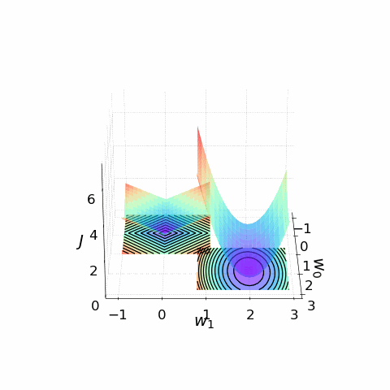
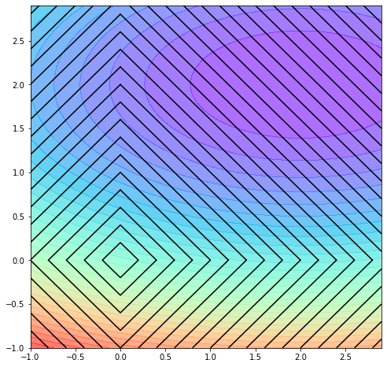

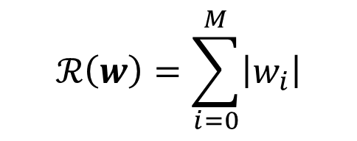
Intuition for $L^{1}$ Regularization
$$𝒥_{reg}\left(w\right)=𝒥\left(w\right)+λℛ\left(w\right)$$
$$𝒥\left(w\right)=\frac{1}{2N}\sum_{j=1}^{N}{{\left(\sum_{i=0}^{M}{w_{i}{\left(x^{\left(j\right)}\right)}^{i}}−y^{\left(j\right)}\right)}^{2}}$$
$$ℛ\left(w\right)=\sum_{i=0}^{M}{\left|w_{i}\right|}$$
$L^{1}$ Regularization can be used as a feature selector

Slide 9
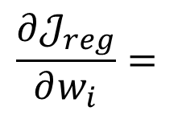
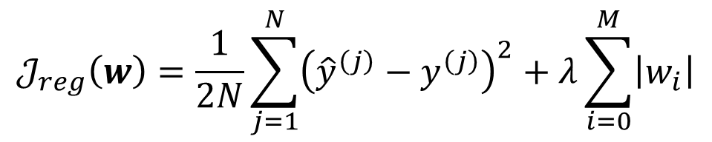
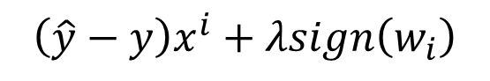
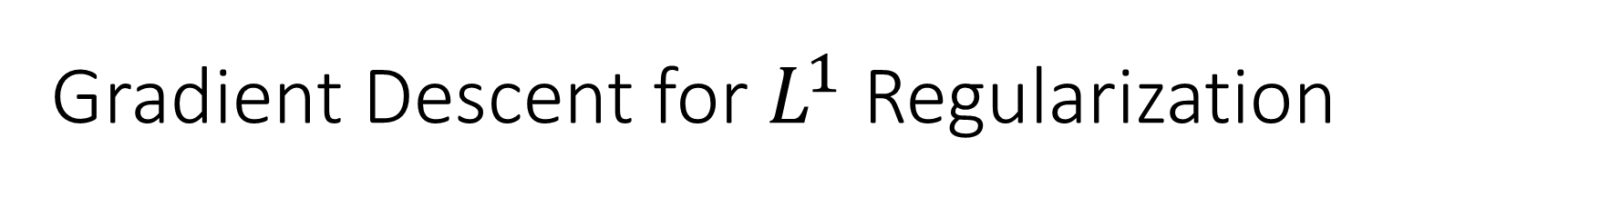
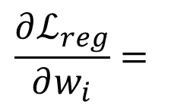
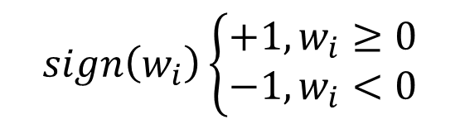
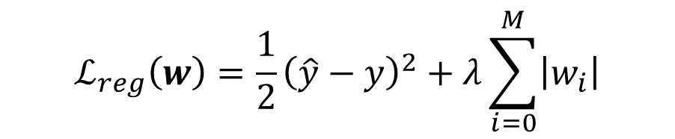
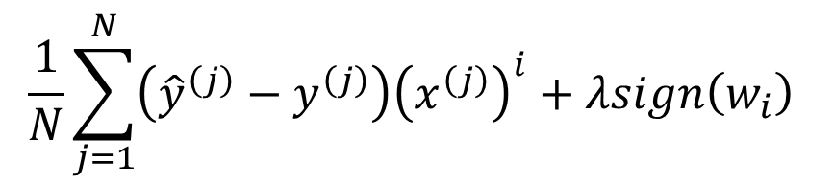
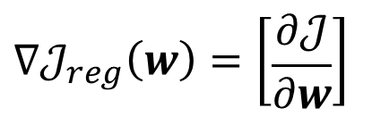
Gradient Descent for $L^{1}$ Regularization
$$sign\left(w_{i}\right)\left\{\begin{aligned}+1, w_{i}≥0 \\ −1, w_{i}<0\end{aligned}\right.$$
Model
Loss Function
$$\hat{y}=\sum_{i=0}^{M}{w_{i}x^{i}}$$
$$ℒ_{reg}\left(w\right)=\frac{1}{2}{\left(\hat{y}−y\right)}^{2}+λ\sum_{i=0}^{M}{\left|w_{i}\right|}$$
$$\frac{∂ℒ_{reg}}{∂w_{i}}=$$
$$\left(\hat{y}−y\right)x^{i}+λsign\left(w_{i}\right)$$
Cost Function
$$𝒥_{reg}\left(w\right)=\frac{1}{2N}\sum_{j=1}^{N}{{\left({\hat{y}}^{\left(j\right)}−y^{\left(j\right)}\right)}^{2}}+λ\sum_{i=0}^{M}{\left|w_{i}\right|}$$
Gradient
$$\frac{1}{N}\sum_{j=1}^{N}{\left({\hat{y}}^{\left(j\right)}−y^{\left(j\right)}\right){\left(x^{\left(j\right)}\right)}^{i}}+λsign\left(w_{i}\right)$$
$$∇𝒥_{reg}\left(w\right)=\left[\begin{matrix}\frac{∂𝒥}{∂w}\end{matrix}\right]$$
$$\frac{∂𝒥_{reg}}{∂w_{i}}=$$

Slide 10
Thank you！

